Slide 1

Project Progress-3 Review Presentation & Demonstration on “FoodFinder : A restaurant recommender system”
Students:
Varsha Ravindra (1RN115CS119)
Sunidhi Hegde (1RN15CS110)
Guide:
Dr. Shashidhara H R
Asst. Prof. Dept. of CSE, RNSIT
Department of Computer Science and Engineering
RNS INSTITUTE OF TECHNOLOGY
2018-19

Slide 2
CONTENTS
INTRODUCTION
Problem Statement
Existing System and Limitations
Proposed system
REQUIREMENTS
Functional Requirements
Non-functional Requirements
Hardware & Software Requirements
SYSTEM ARCHITECTURE/BLOCK DIAGRAM
System architecture
DETAILED DESIGN (Module wise)
Modules implemented
Libraries used / API’s
IMPLEMENTATIONS (Module wise)
Algorithm/Methods/Pseudo code
RESULT ANALYSIS
Snapshots
CONCLUSION
Conclusion
Future work to be carried out
REFERENCES

Slide 3
INTRODUCTION
Problem Statement
Providing related content out of relevant and irrelevant collection of items to users of online service providers.
Restaurant recommender system aims to recommend restaurants to users based on user-restaurant ratings, reviews, price and location

Slide 4
DETAILED DESIGN
Modules implemented:
Data scraping
Data cleaning
UI Design
Quiz for a new user

Slide 5
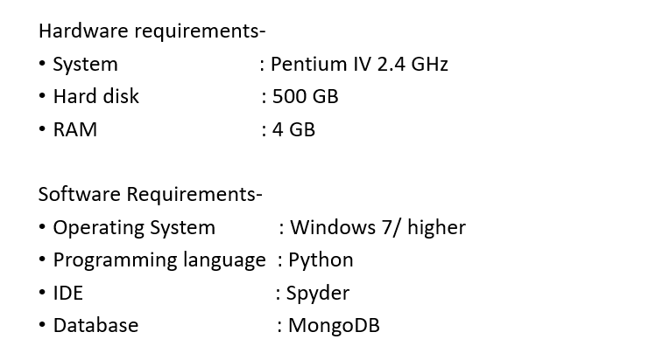
REQUIREMENTS
Hardware and Software Requirements:

Slide 6
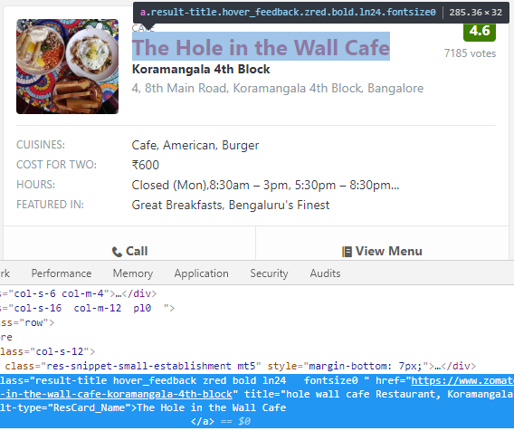
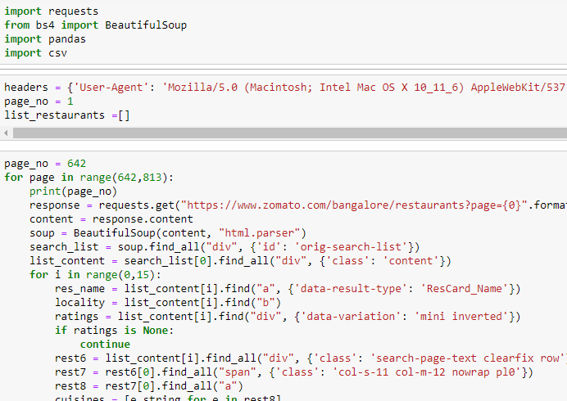
Web Scraping using BeautifulSoup

Slide 7
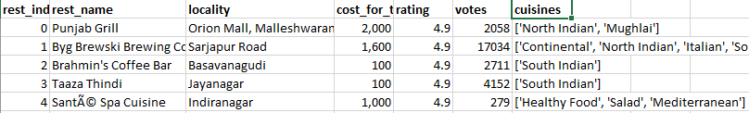


Data Cleaning and Preparation
Removing restaurants with no ratings.
Get a list of unique cuisines.
Strip the data of whitespaces.
Sort the restaurants.

Slide 8
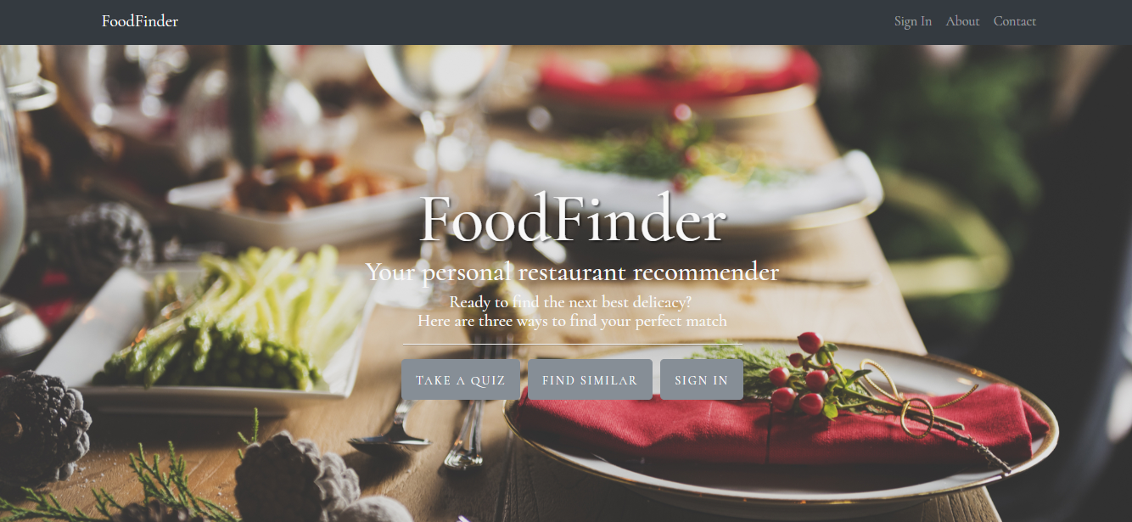
UI Design
Home page:

Slide 9
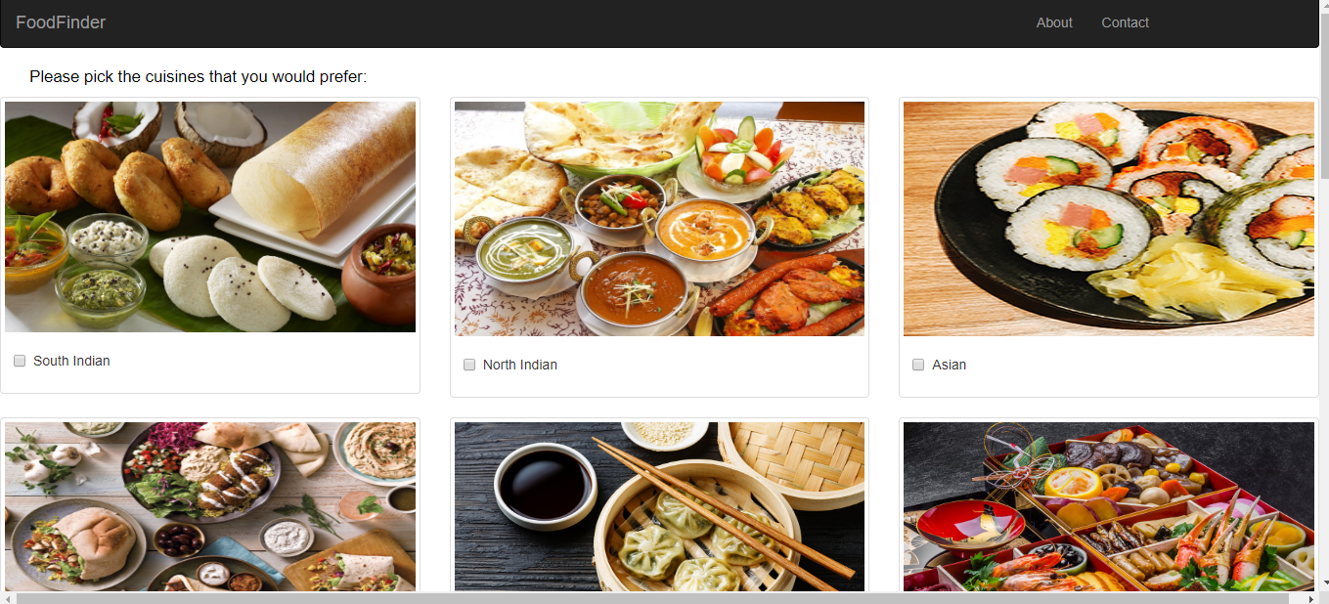
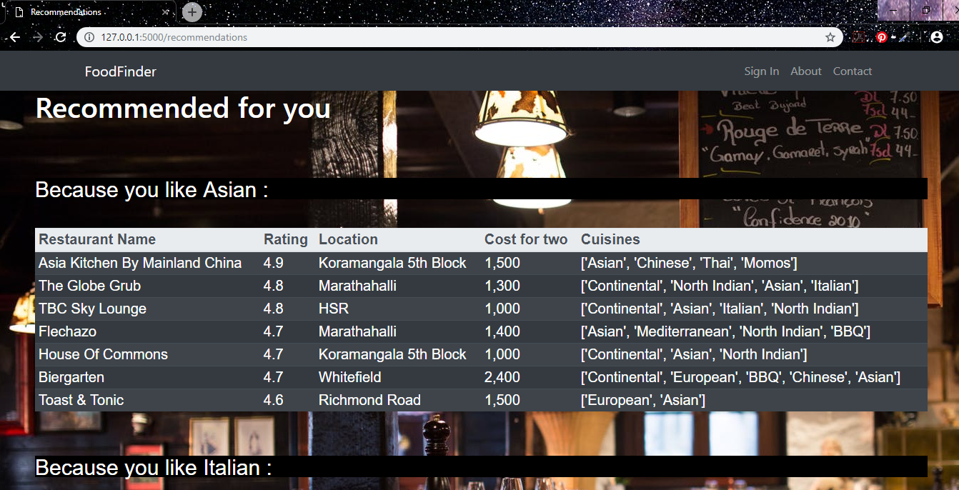
QUIZ FOR NEW USER

Slide 10
Algorithm for ‘take your pick’
Determine the minimum number of votes required by a restaurant to be listed in qualified_restaurants.
min_votes = df['votes'].quantile(0.50)
Calculate the ‘score’ for each restaurant using the formula: (v/(v+m) * R) + (m/(m+v) * C)
where v – number of votes
m – min_votes calculated in the previous step
R – rating of each restaurant
C – average rating
Arrange restaurants in decreasing order of score.
Input the list of cuisines.
Match the restaurants containing the cuisines.
Select top 7 restaurants for recomendations.

Slide 11
Future work to be carried out
Current status of the project completion (%) : 80%
Work to be carried out :
Implement content based and collaborative filtering.

Slide 12
REFERENCES
[1] Hybrid recommender systems: Survey and experiments, User-modelling and User-adapted interactions , November 2002
[2] https://www.sciencedirect.com/science/article/pii/S1110866515000341
[3] https://www.datacamp.com/community/tutorials/recommender-systems-python
[4] https://en.wikipedia.org/wiki/Recommender_system
[5] https://www.marutitech.com/recommendation-engine-benefits/
[6] https://towardsdatascience.com/my-journey-to-building-book-recommendation-system-5ec959c41847

Slide 13

PROJECT SETUP AND DEMONSTRATION

Slide 14
Suggestions….!

Slide 15
THANK YOU!!!

